Slide 1
Front Back End templates
from flask import Flask, render_template
app = Flask(__name__)
@app.route('/', methods=['GET','POST'])
def index():
return(render_template("index.html"))
if __name__ == '__main__':
app.run()
styles css: https://1drv.ms/u/s!Aik2a4x7tvLymZ5z6m5nmFBF9z35lg?e=HCZKgj
flask
gunicorn
<head>
<meta name="viewport" content="width=device-width, initial-scale=1.0">
<link rel="stylesheet" href="{{ url_for('static', filename='styles.css') }}">
</head>
<body>
<div class="container">
<h1>Hello, Flask!</h1>
</div>
</body>

Slide 2
Dbs share price prediction with deployment
import pandas as pd
df = pd.read_csv("/content/DBS_SingDollar.csv")
df
X = df.loc[:,["SGD"]]
y = df.loc[:,["DBS"]]
from sklearn import linear_model
regr = linear_model.LinearRegression()
regr.fit(X, y)
print(regr.coef_[0][0])
print(regr.intercept_[0])
from sklearn.metrics import mean_squared_error
y_pred = regr.predict(X)
print("Root Mean squared error: %.2f" % mean_squared_error(y, y_pred)**0.5)
styles css: https://1drv.ms/u/s!Aik2a4x7tvLymZ5z6m5nmFBF9z35lg?e=HCZKgj

Slide 3
app.py
app.py
from flask import Flask,render_template,request
app = Flask(__name__)
@app.route("/",methods=["GET","POST"])
def index():
return(render_template("index.html"))
@app.route("/prediction",methods=["GET","POST"])
def prediction():
q = float(request.form.get("q"))
return(render_template("prediction.html", r=(-50.6*q)+90.2))
if __name__ == "__main__":
app.run()

Slide 4
Index.html prediction.html requirements.txt
index.html
<head>
<meta name="viewport" content="width=device-width, initial-scale=1.0">
<link rel="stylesheet" href="{{ url_for('static', filename='styles.css') }}">
</head>
<body>
<div class="container">
<h2>DBS share price prediction</h2>
<form action="/prediction" method="post">
<p>Please enter USD/SGD exchange rate </p>
<input type="number" step="0.01" name="q">
<input type="submit" value="Enter">
</form>
</div>
</body>
prediction.html
<head>
<meta name="viewport" content="width=device-width, initial-scale=1.0">
<link rel="stylesheet" href="{{ url_for('static', filename='styles.css') }}">
</head>
<body>
<div class="container">
<h2>Predicted DBS share price : {{r}}</h2>
<form action="/" method="post">
<input type="submit" value="Main">
</form>
</div>
</body>
requirements.txt
gunicorn
flask

Slide 5
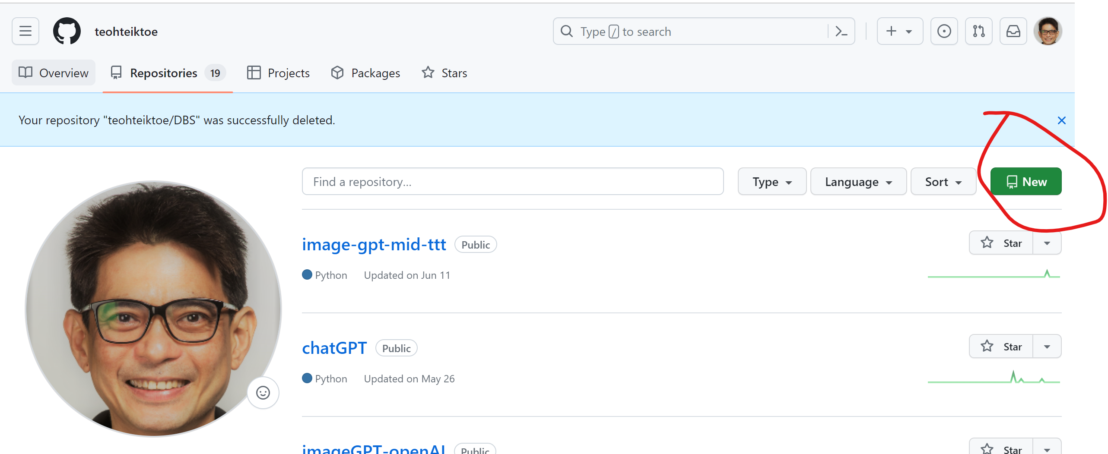
Deploy in render - need to create new repository in github
requirements.txt
flask
replicate
Gunicorn
google-generativeai
openai

